Slide 1


Introduction to Adaptability Assessment
An adaptability assessment is a crucial tool for evaluating the capability of a solution to adjust to varying conditions, requirements, or challenges. This type of assessment seeks to determine whether a solution can effectively modify its approach, parameters, or characteristics in response to changing circumstances. It plays a key role in ensuring the resilience and versatility of a solution, contributing to its long-term success.

Slide 2

Importance of Testing Adaptability in Solutions
1
Resilience and Flexibility
Testing the adaptability of solutions is vital for ensuring their resilience in dynamic and unpredictable environments. It allows businesses to identify potential weaknesses and make necessary adjustments to improve their responsiveness.
2
Competitive Advantage
Adaptability testing enables organizations to stay ahead in the market by quickly adapting to changes in customer demands, technological advancements, and industry trends.
3
Risk Mitigation
By uncovering areas that lack adaptability, organizations can proactively mitigate risks associated with unforeseen market shifts, regulatory changes, or external disruptions.

Slide 3
Overview of the Test Case: Comprehensive Gauging of Adaptability
1
Scenario Variations
2
Parameter Modification
3
Real-world Simulations
Examining the solution's ability to adapt to diverse scenarios and contexts, ranging from steady-state operations to crisis management situations.
Assessing the solution's adaptability by adjusting the weightage and significance of different parameters and variables affecting its performance.
Utilizing real-world simulations to evaluate the solution's capacity to adapt to complex and evolving business environments.

Slide 4
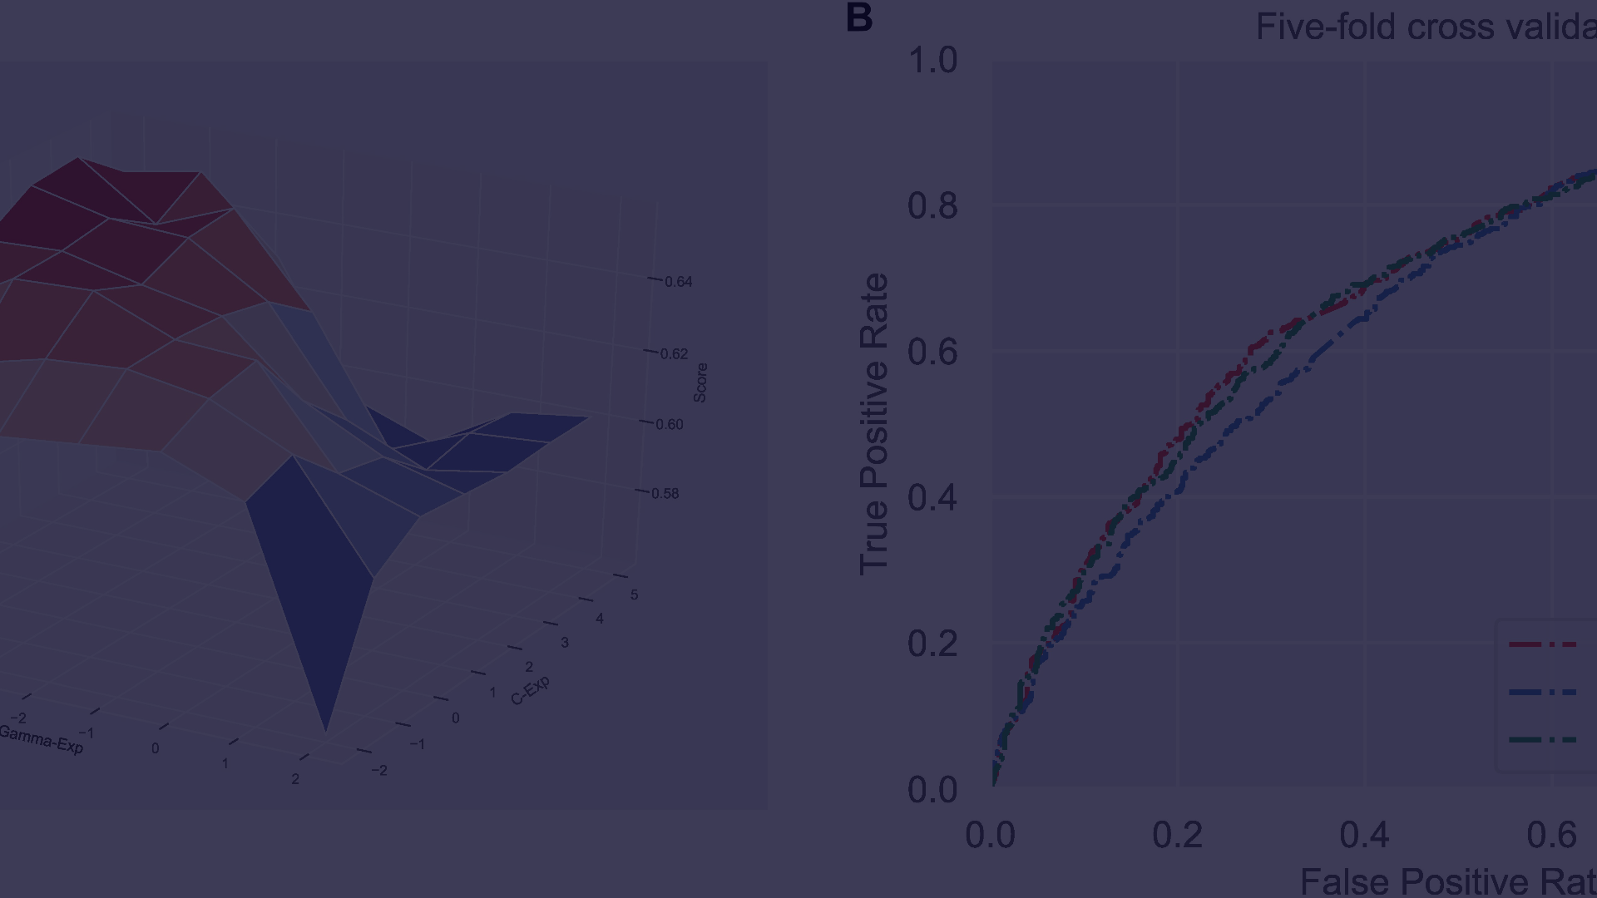
Modifying Weightage for Parameters in the Assessment
Identify Key Parameters
Adjust Weightage Levels
Evaluate Comparative Performance
Begin by identifying the parameters that significantly influence the adaptability of the solution in real-world scenarios.
Modify the weightage assigned to each parameter based on its criticality and impact on the adaptability of the solution.
Assess the comparative performance of the solution across various weightage configurations to determine the optimal balance.

Slide 5




Accommodating Different Scenarios and Variables
Diverse Scenario Testing
Variable Impact Analysis
Dynamic Environment Modeling
Conducting tests across a wide range of scenarios, including sudden market shifts, technological disruptions, and regulatory changes.
Assessing the impact of variables such as market volatility, customer behavior, and competitive dynamics on the adaptability of the solution.
Creating dynamic models to replicate evolving business environments and testing the solution's adaptability under these varying conditions.

Slide 6
Challenges in Assessing Adaptability
Complexity of Variables
Predicting Unforeseen Scenarios
Data Accuracy and Reliability
Managing the complexity of multiple interdependent variables and their influence on the adaptability of the solution.
Anticipating and preparing for unforeseen scenarios and disruptions that may pose challenges to the adaptability assessment process.
Ensuring the accuracy and reliability of the data used for testing, especially when simulating real-world scenarios and variables.

Slide 7
Best Practices for Conducting the Adaptability Assessment
1
2
3
Thorough Scenario Mapping
Collaborative Cross-functional Approach
Continuous Iterative Testing
Comprehensively mapping out diverse scenarios and variables for comprehensive adaptability testing.
Engaging cross-functional teams to provide diverse perspectives and expertise in conducting the assessment.
Implementing a cycle of continuous testing and refinement to adapt to evolving business dynamics and challenges.

Slide 8
Conclusion and Key Takeaways
Adaptability Testing
Significant for mitigating risks and ensuring solution resilience.
Continuous Improvement
Emphasizes the need for ongoing adaptability assessment and refinement efforts.
Strategic Alignment
Underlines the importance of aligning adaptability testing with organizational strategies and goals.

